Slide 1
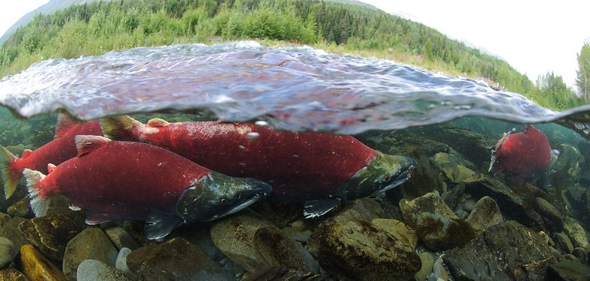
Draw a Riparian Ecosystem
U.S. Department of the Interior Bureau of Land Management
Module 3 Reflection
Photo by K.Yasui, USFS.

Slide 2
Materials:
U.S. Department of the Interior Bureau of Land Management
science journal or a piece of paper
something to write with
coloring supplies (optional)

Slide 3
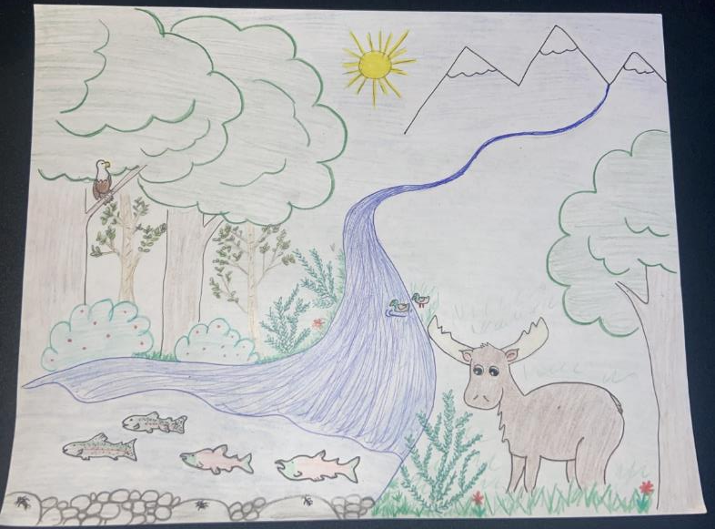
U.S. Department of the Interior Bureau of Land Management
Draw a riparian ecosystem!
Your riparian ecosystem must include:
the sun
a waterway
at least one producer (plant)
at least two consumers:
one animal that eats plants
one animal that eats animals
aquatic macroinvertebrates
Graphic by CCSC staff, BLM.

