Slide 1
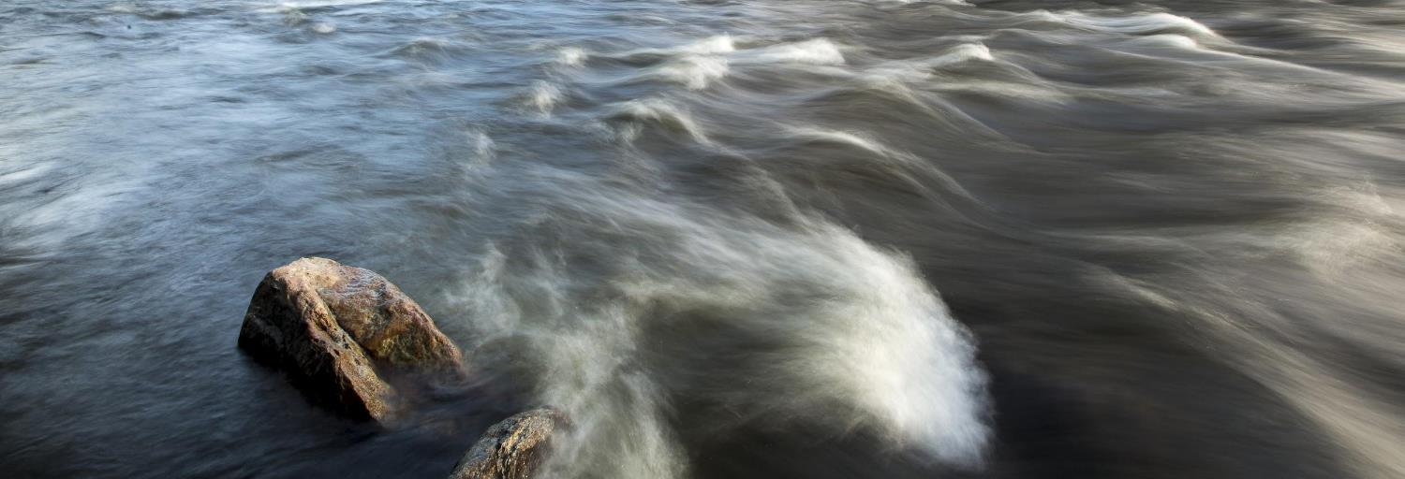
What Is Water Quality?
U.S. Department of the Interior Bureau of Land Management
Module 2 Introduction
Photo by B. Wick, BLM.

Slide 2
Module 2: Water Quality
Module Questions:
U.S. Department of the Interior Bureau of Land Management
Why is water quality important?
How do scientists measure water quality?
How can people’s actions impact water quality?

Slide 3
Materials:
U.S. Department of the Interior Bureau of Land Management
science journal or a piece of paper
something to write with

Slide 4
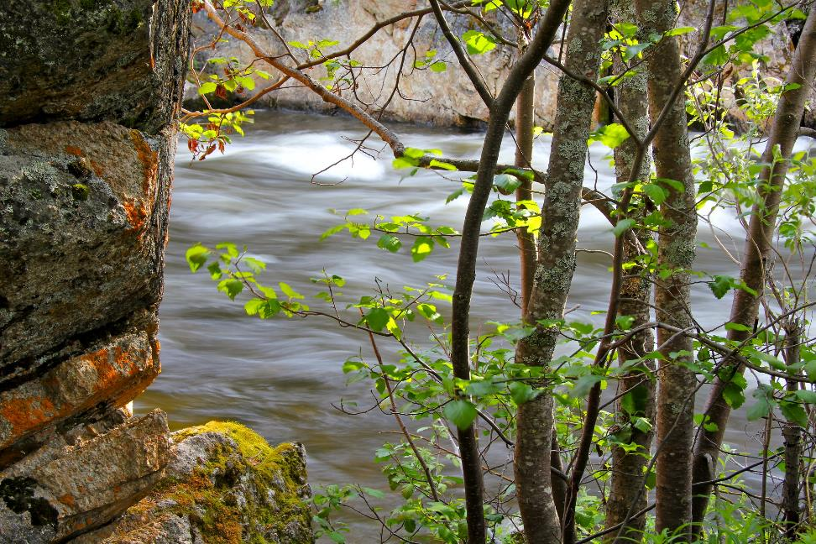
Watersheds are systems that connect water, land, air, and living things.
U.S. Department of the Interior Bureau of Land Management
Rocks and trees stand in the forefront of rapidly moving water.
Photo by J. Matlock, BLM.

Slide 5
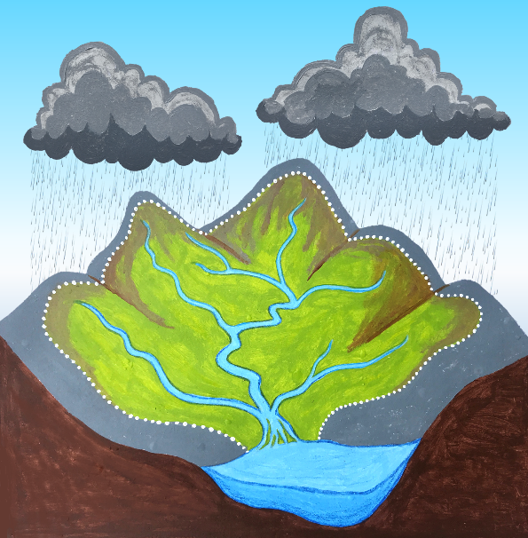
Rain or snow that falls in a watershed eventually drains into a waterway. A waterway is a body of water, such as a stream, creek, river, or lake.
U.S. Department of the Interior Bureau of Land Management
The dotted line shows the watershed boundary.
The land in the watershed boundary drains into this waterway.
Graphic by M. Harris, BLM.

Slide 6
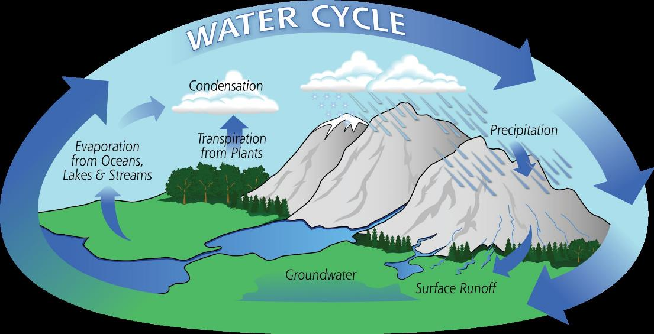
Remember, water is not created or destroyed in the water cycle but changed into different forms.
U.S. Department of the Interior Bureau of Land Management
Graphic by NASA

Slide 7
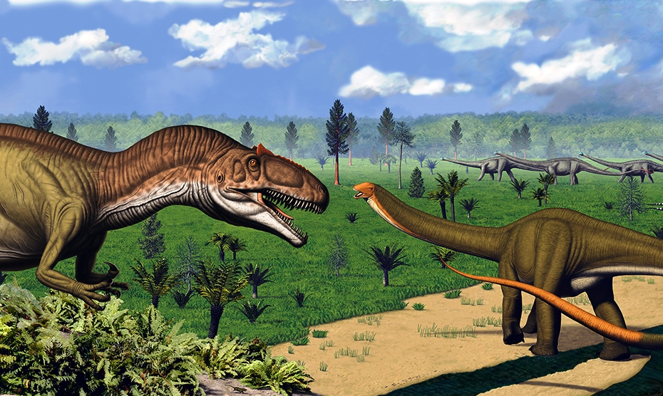
That means the water we drink today is the same water the dinosaurs drank 65 million years ago!
U.S. Department of the Interior Bureau of Land Management
Graphic by NPS
Notes:
Image from Microsoft 365

Slide 8
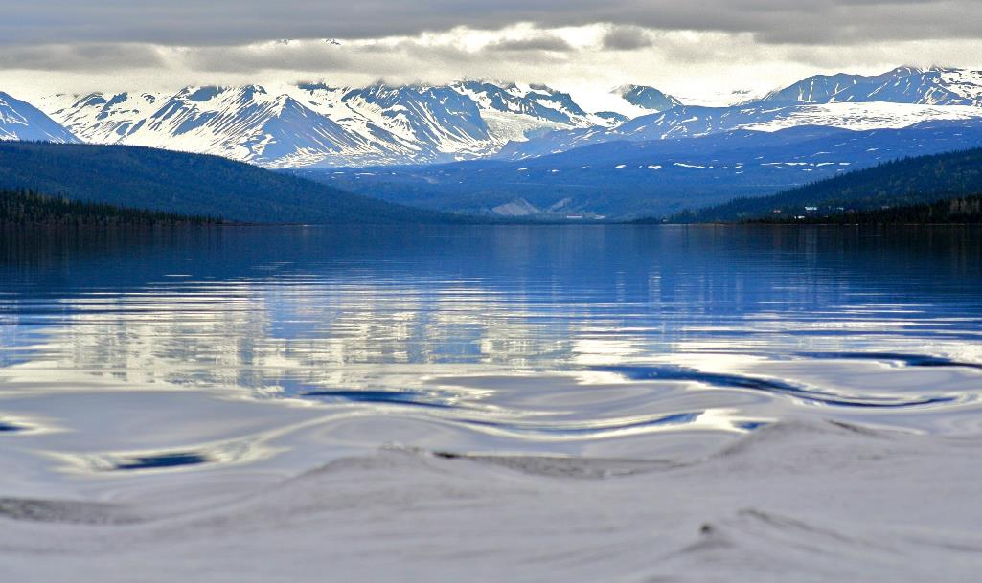
All waterways have water quality. Water quality is the measurement of how clean and healthy the water is.
U.S. Department of the Interior Bureau of Land Management
Relatively calm water settles in the mountain valley. Photo by J. Matlock, BLM.

Slide 9
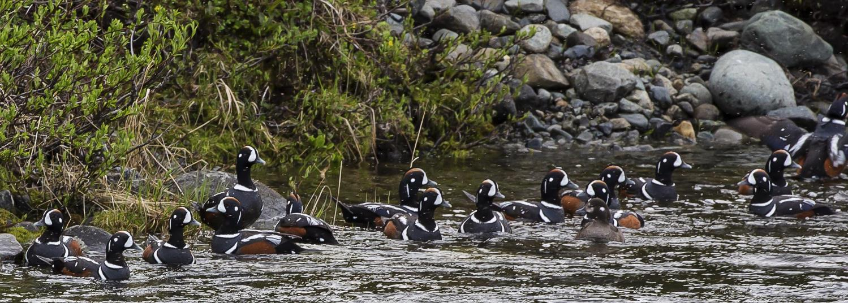
Water with high quality is clean and healthy for living things in the watershed, including humans.
U.S. Department of the Interior Bureau of Land Management
Harlequin ducks get their feathers wet.
Photo by B. Wick, BLM.

Slide 10
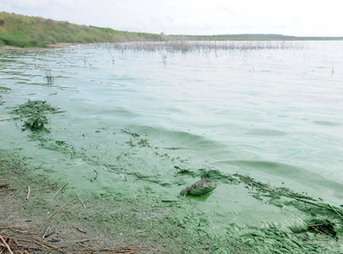
Water with poor quality is unclean and unhealthy for living things in the watershed, including humans.
U.S. Department of the Interior Bureau of Land Management
A green film covers the surface of the water.
Photo by USFWS.

Slide 11
Most of the water on Earth is salt water. Only about three percent of all the water on Earth is fresh water.
U.S. Department of the Interior Bureau of Land Management
Graphic by CCSC staff.

Slide 12
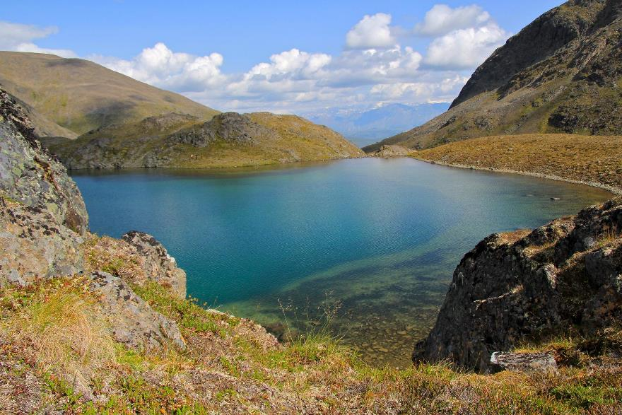
Because there is a limited supply of fresh water on Earth, and so many living things depend on it, it is important to keep fresh water healthy.
U.S. Department of the Interior Bureau of Land Management
Fresh water lake.
Photo by J. Matlock, BLM.

Slide 13
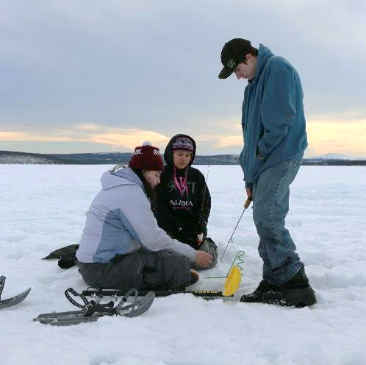
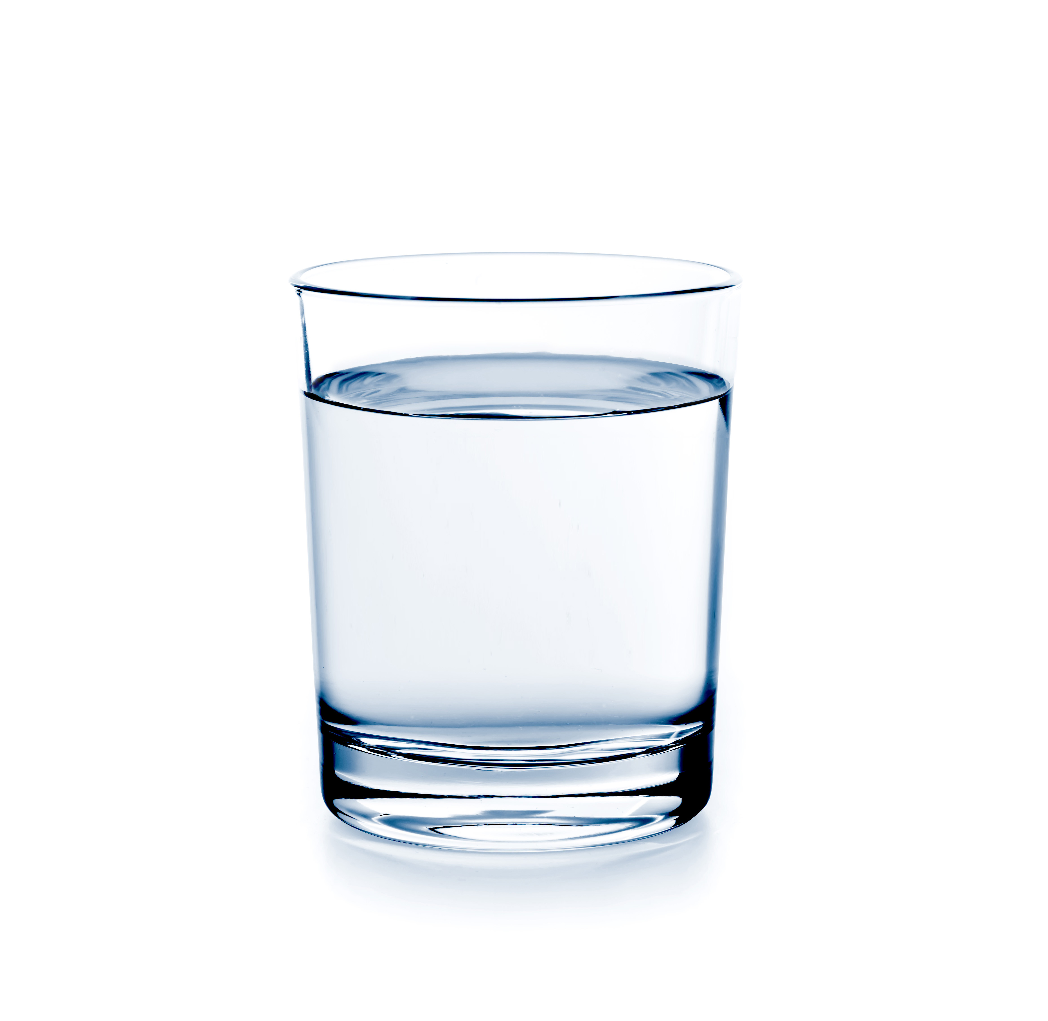
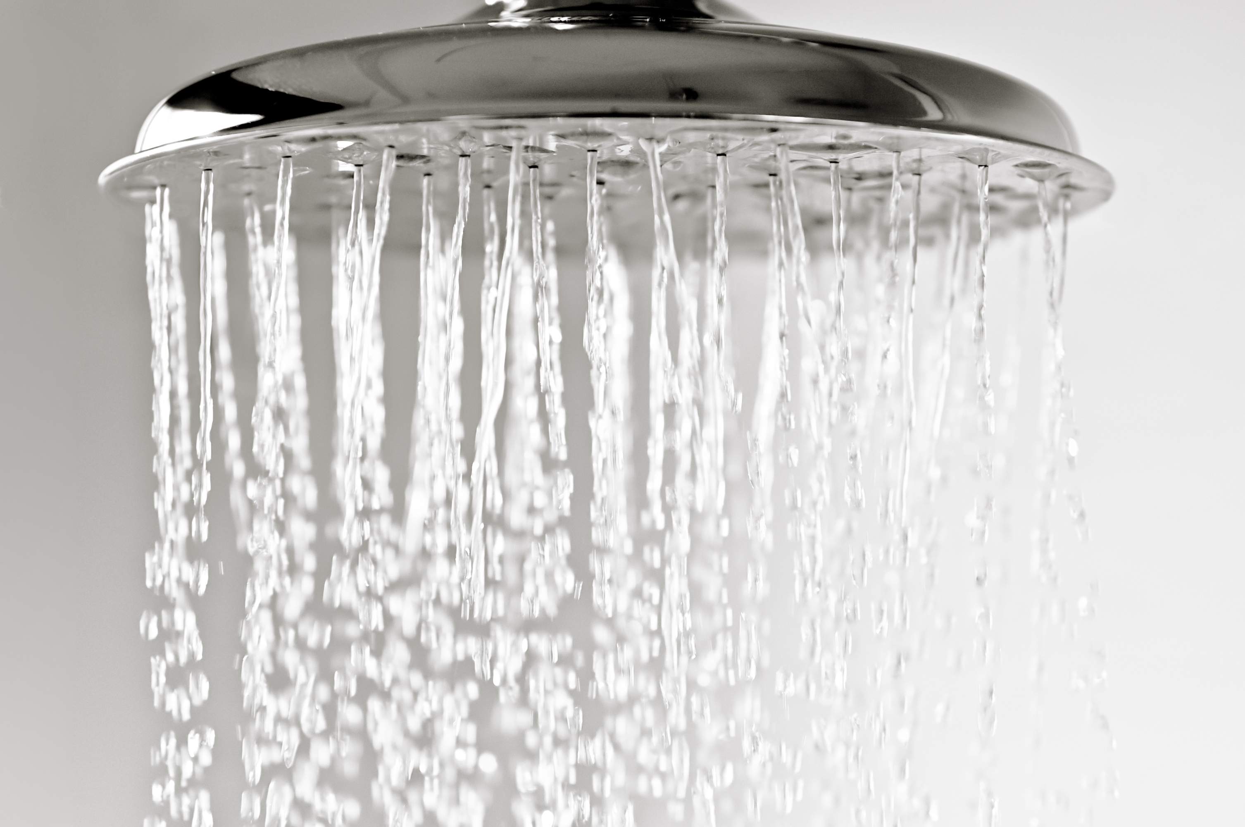
Why is water quality important to you? Write down at least five ways you use water in your daily life in your science journal or on a piece of paper.
U.S. Department of the Interior Bureau of Land Management
© Microsoft
© Microsoft
Three people enjoy ice fishing on a frozen lake. Photo by M. Graham, BLM.
Notes:
Left and right images from Microsoft 365

Slide 14
In Alaska, scientists ask three main questions to determine water quality.
U.S. Department of the Interior Bureau of Land Management
Is the water clean?
Is the water cold?
Does the water have lots of oxygen?

Slide 15
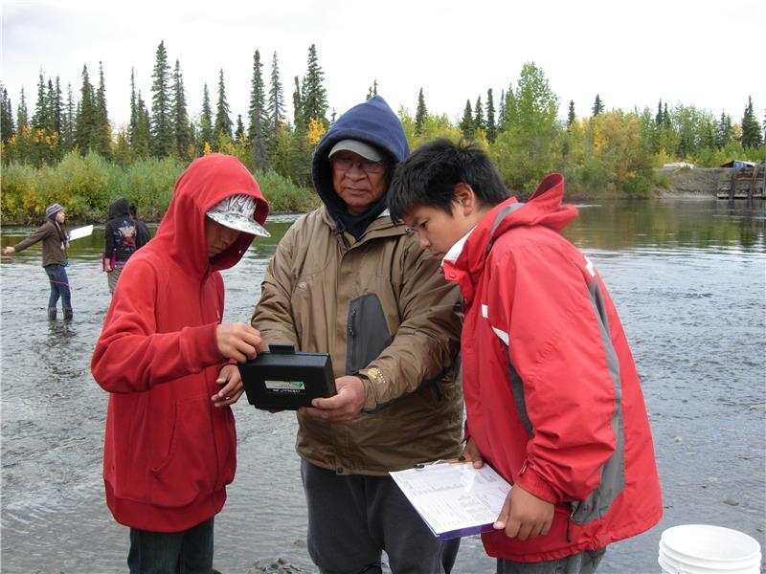
Scientists make observations and conduct water quality tests to answer the questions.
U.S. Department of the Interior Bureau of Land Management
Scientists observe water quality tests.
Photo by CCSC staff, BLM.

Slide 16
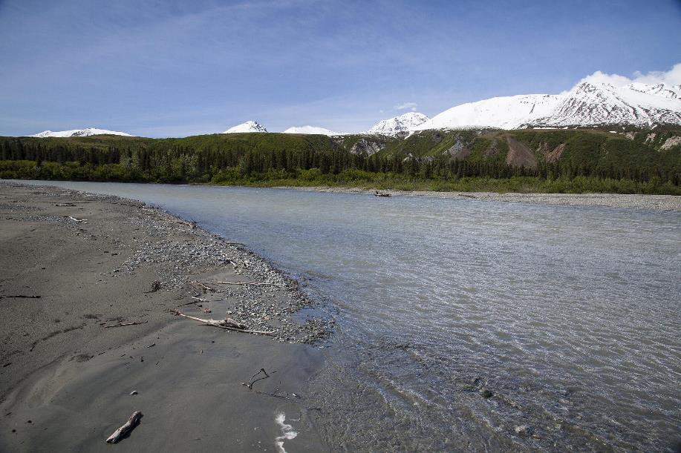
Clean water has little or no pollution, such as trash, fertilizers, oils, metals, and harmful bacteria.
U.S. Department of the Interior Bureau of Land Management
Pacific salmon depend on clean water to survive.
Photo by B. Wick, BLM.

Slide 17
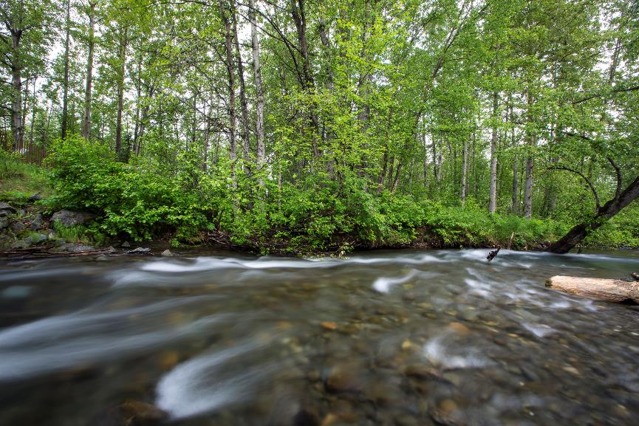
Clear does not always mean clean. Some waterways, like Campbell Creek in Anchorage, have clear water but also have pollution.
U.S. Department of the Interior Bureau of Land Management
Campbell Creek in Anchorage, Alaska.
Photo by B. Wick, BLM.

Slide 18
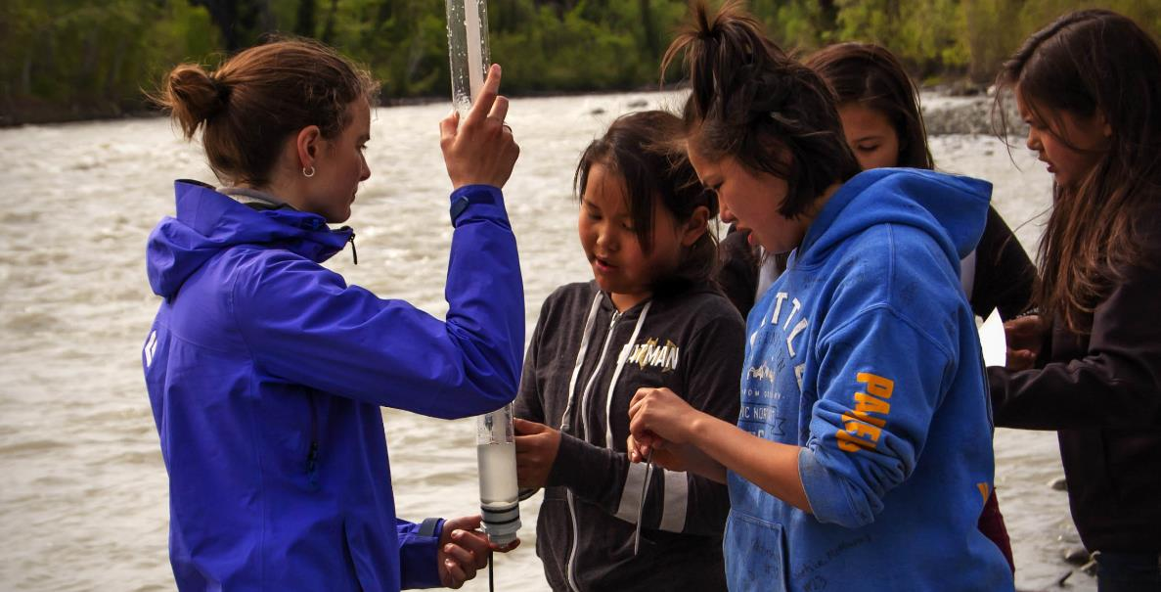
Some rivers are clean but not clear. The Klutina River near Copper Center is clean but full of glacial silt, which makes the color murky.
U.S. Department of the Interior Bureau of Land Management
Water with high levels of glacial silt is not clear.
A group of scientists observe water clarity.
Photo by A. Friendshuh, BLM.

Slide 19
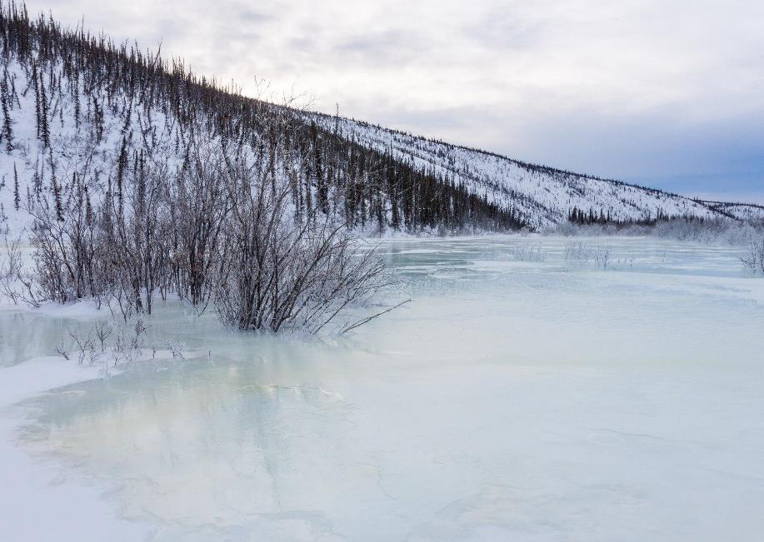
Cold water is important for fish and other underwater animals that have bodies adapted to live in low temperatures. Cold water also holds more oxygen than warm water.
U.S. Department of the Interior Bureau of Land Management
A frozen body of water in Alaska.
Photo by C. McCaa, BLM.

Slide 20
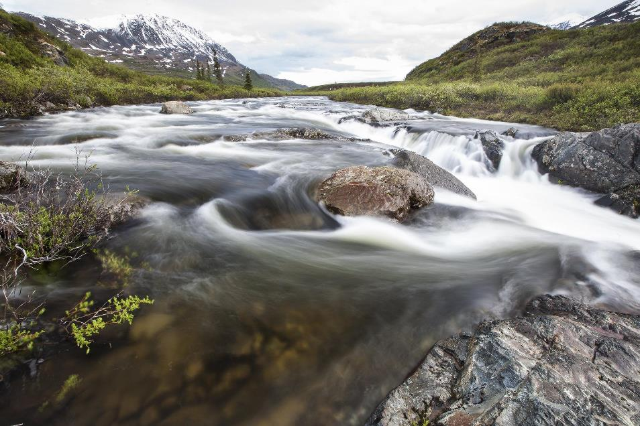
Healthy creeks, rivers, and lakes have abundant dissolved oxygen, which is the amount of oxygen present in the water.
U.S. Department of the Interior Bureau of Land Management
Fish and other underwater animals need dissolved oxygen to survive.
Clean and healthy streams are vital to Pacific salmon survival.
Photo by B. Wick, BLM.

Slide 21
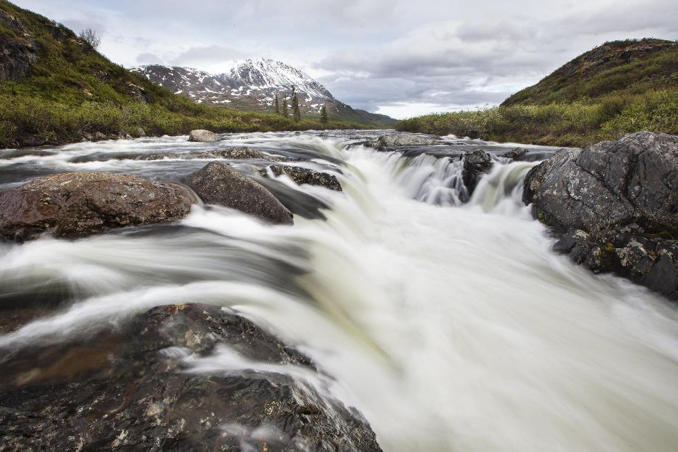
Fast moving water, like the river you see in this picture, usually has high amounts of dissolved oxygen.
U.S. Department of the Interior Bureau of Land Management
Water that flows slowly tends to have less dissolved oxygen.
This fast moving water likely has high amounts of dissolved oxygen – an important element for salmon survival.
Photo by B. Wick, BLM.

Slide 22
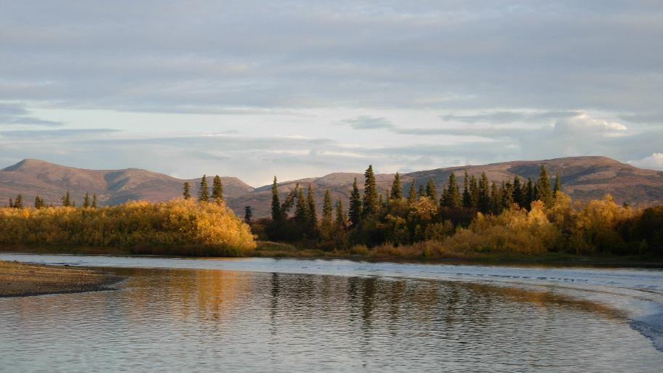
Extension Activity:
U.S. Department of the Interior Bureau of Land Management
Ask an elder or someone in your family why healthy water quality is important to them.
A body of water pictured below mountains, rolling hills and trees. Photo by BLM.

