Slide 1
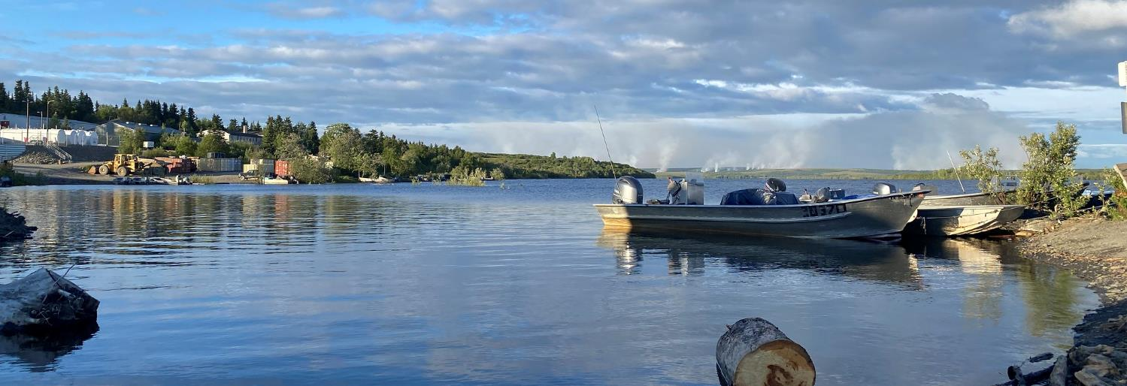
Your Watershed
U.S. Department of the Interior Bureau of Land Management
Discover the watershed you live in
Module 1 Reflection
Jacob Welsh/BLM

Slide 2
Everyone lives in a watershed! To learn which watershed you live in, follow the link below and enter your full address or zip code.
U.S. Department of the Interior Bureau of Land Management
https://mywaterway.epa.gov/
This website shows you the smallest watershed you live in. For example, it may show you live in the Little Campbell Creek watershed, which is a part of the larger Campbell Creek watershed.
For some watersheds, this website will share monitoring data about the rivers, streams, and lakes in the watershed.

